Slide 1
Claude Code Fundamentals
- © 2026 AIA Copilot
Notes:
TIME: 2 minutes
OPEN WITH:
Welcome to Claude Code Fundamentals! By the end of today, you'll be able to set up, configure, and use Claude Code as a powerful development partner in your daily workflow.
KEY POINTS:
* Welcome everyone to Day 2 of our training series
* Today we're diving into Claude Code - the CLI tool that brings AI directly into your terminal
* This is hands-on training with two labs where you'll actually use Claude Code
* By end of day, you'll understand how Claude thinks, how to configure it for your projects, and how to use it securely in production
TRANSITION:
Let's start by looking at what we'll cover today.

Slide 2
Today's Agenda
Morning (9:00 AM - 12:00 PM)
Afternoon (1:00 PM - 4:00 PM)
Introduction & Setup
30 min
Slash Commands
45 min
The Agentic Loop
45 min
Permissions & Security
45 min
CLAUDE.md & Configuration
30 min
Break
15 min
@ Mentions & Context
30 min
Git Integration
45 min
Break
15 min
File Operations & Workflows
45 min
Context Management
45 min
Lab 2 & Wrap-up
45 min
Lab 1: Setup & First Project
45 min
Notes:
TIME: 2 minutes
KEY POINTS:
* Morning focuses on fundamentals - installation, understanding how Claude thinks, and project configuration
* The Agentic Loop section is critical - this is the mental model you need to work effectively with Claude
* First lab will get everyone's environment set up and working on real code
* Afternoon covers advanced features - commands, security, Git integration, and real workflows
* Second lab is a realistic debugging and development scenario
* We have two 15-minute breaks scheduled, but feel free to stretch or grab coffee anytime
TRANSITION:
Before we dive in, let's talk about what you'll be able to do by the end of today.

Slide 3
Learning Objectives
v
Install and configure Claude Code in your development environment
v
Understand the agentic loop and how Claude processes your requests
v
Configure projects with CLAUDE.md to match your team's standards
v
Use @ mentions and context management for efficient AI assistance
v
Execute secure workflows with proper permissions and safeguards
v
Integrate Claude Code with Git for automated commits and PR creation
Notes:
TIME: 3 minutes
KEY POINTS:
* These are concrete, practical skills you'll leave with today
* Installation is straightforward, but we'll cover common issues
* Understanding the agentic loop is what separates good Claude users from great ones
* CLAUDE.md is how you teach Claude about YOUR specific project
* Context management is about getting better results with less token usage
* Security is non-negotiable - we'll show you how to use Claude safely in production
* Git integration makes Claude a true development partner, not just a code generator
REAL-WORLD EXAMPLE:
By tomorrow, you should be able to point Claude at a real codebase, have it understand your conventions, and safely make changes that you'd trust in production.
TRANSITION:
First, let's clarify what Claude Code actually is.

Slide 4
What is Claude Code?
AI-powered development tool that lives in your terminal
Notes:
TIME: 2 minutes
KEY POINTS:
* Claude Code is the CLI version of Claude - it runs in your terminal, not a browser
* It has full access to your file system, can read your code, execute commands, and make changes
* Think of it as an AI pair programmer that can see your entire codebase
* Unlike Claude.ai which is conversational, Claude Code is action-oriented
* It's designed specifically for software development workflows
REAL-WORLD EXAMPLE:
Instead of copying code to Claude.ai, explaining your project, and pasting results back, Claude Code already knows your codebase and can directly edit files.
TRANSITION:
Let's see how Claude Code differs from the web interface you might already know.

Slide 5
Claude Code vs Claude.ai
Claude.ai
Claude Code
Browser-based interface
Chat-focused interaction
Upload files manually
General-purpose tasks
Copy/paste workflow
No direct system access
Terminal/CLI based
Reads your entire codebase
Executes commands directly
Developer-focused workflows
Direct file editing
Integrated with your tools
Notes:
TIME: 3 minutes
KEY POINTS:
* Claude.ai is great for conversations, brainstorming, general questions
* Claude Code is purpose-built for software development
* Key difference: Claude Code can take actions - read files, write code, run commands, commit to Git
* With Claude.ai you're the executor - with Claude Code, it's the executor
* Both use the same underlying models, but the interface and capabilities are different
* Use Claude.ai for planning and architecture discussions, Claude Code for implementation
ASK THE CLASS:
"How many of you have used Claude.ai? How many have wished it could just make the changes for you?"
[PAUSE for 30-60 seconds]
TRANSITION:
Now let's get Claude Code installed and running on your machines.

Slide 6
Installation & Setup
Getting Claude Code Running
Notes:
TIME: 1 minute
KEY POINTS:
* Next 30 minutes covers installation and initial configuration
* We'll go step by step so everyone gets set up correctly
* If you run into issues, raise your hand - we've seen all the common problems
TRANSITION:
Here's the installation process step by step.

Slide 7
Installation Steps
1
2
3
4
5
Check Node.js 18+ is installed
Run: npm install -g @anthropic-ai/claude-code
Verify installation: claude --version
Set your Anthropic API key
Navigate to a project directory and run: claude
Notes:
TIME: 4 minutes
KEY POINTS:
* First requirement: Node.js version 18 or higher - check with 'node --version'
* If you don't have Node, install from nodejs.org or use nvm
* The npm install is global (-g flag) so claude command is available everywhere
* Verification step is important - make sure you see a version number, not an error
* API key can be set as environment variable ANTHROPIC_API_KEY or through configuration
* Once installed, just run 'claude' in any project directory to start
REAL-WORLD EXAMPLE:
Installation takes about 2 minutes on a fresh system. The npm package is small - around 50MB.
TRANSITION:
Once installed, here are the first commands you should try.

Slide 8
First Commands
BASH
claude "explain this codebase" claude "find all TODO comments" claude "what does the auth module do?"
Notes:
TIME: 3 minutes
KEY POINTS:
* Claude Code accepts natural language commands in quotes
* First command: 'explain this codebase' - Claude will read your files and give you an overview
* Second command: practical search - finding all TODO comments across the project
* Third command: targeted question about a specific module
* Claude will read relevant files automatically - you don't need to specify what to read yet
* These are exploratory commands - safe, read-only, great for getting started
REAL-WORLD EXAMPLE:
When joining a new project, start with 'explain this codebase' - Claude will give you a better overview than most documentation.
TRANSITION:
Now let's talk about configuration options.

Slide 9
Configuration Options
Environment
Project
API keys and credentials
Model defaults (Sonnet/Opus)
Output format preferences
Global settings
.claude/ directory
CLAUDE.md instructions
.claudeignore patterns
Per-project overrides
Notes:
TIME: 4 minutes
KEY POINTS:
* Two levels of configuration: global environment settings and per-project settings
* Environment config goes in your shell profile or .env files
* Most important environment variable: ANTHROPIC_API_KEY
* Project config is stored in .claude/ directory at your project root
* CLAUDE.md is where you tell Claude about your project - we'll cover this in detail soon
* .claudeignore works like .gitignore - tells Claude which files to skip
* Project settings override environment defaults
TRANSITION:
Let's see this in action with a live installation demo.

Slide 10
DEMO
Demo: Installation & First Run
Live installation and first commands
Notes:
TIME: 5 minutes
KEY POINTS:
* Open terminal and verify Node version: node --version
* Run installation: npm install -g @anthropic-ai/claude-code
* Show the installation progress and output
* Verify: claude --version
* Navigate to a sample project directory
* Run: claude "explain this codebase"
* Show Claude reading files and generating the explanation
* Run one more command: claude "find all functions that handle errors"
* Point out how Claude automatically explores the relevant files
REAL-WORLD EXAMPLE:
Notice how Claude doesn't ask for clarification - it just starts working. That's the agentic loop in action.
DEMO:
Perform live installation on a clean terminal
TRANSITION:
Now let's troubleshoot common installation issues you might encounter.

Slide 11
Troubleshooting Common Issues
Node version too old → Upgrade to Node 18+ or use nvm to manage versions
API key errors → Check ANTHROPIC_API_KEY is set correctly in environment
Permission denied → Don't use sudo; fix npm permissions or use nvm
Network/proxy issues → Configure npm proxy settings or use corporate CA certs
Model not available → Check your API tier has access to requested model
Notes:
TIME: 4 minutes
KEY POINTS:
* Most common issue: outdated Node version - many systems still have Node 16 or older
* API key problems usually mean the environment variable isn't set or has typos
* Never install npm global packages with sudo - it causes permission problems later
* Corporate networks may require proxy configuration in npm
* Model availability depends on your API tier - Opus requires higher tier access
* If you see any of these errors, we have solutions - just ask
REAL-WORLD EXAMPLE:
In corporate environments, the proxy issue is most common. Have your IT provide the proxy URL and CA certificates.
TRANSITION:
Now that everyone has Claude Code installed, let's talk about how it actually works under the hood.

Slide 12
The Agentic Loop
How Claude Code Actually Works
Notes:
TIME: 1 minute
KEY POINTS:
* This is the most important section of the day
* Understanding the agentic loop changes how you interact with Claude
* This is not just theory - it's the mental model you need to be effective
TRANSITION:
Let me introduce you to the core concept that makes Claude Code powerful.

Slide 13
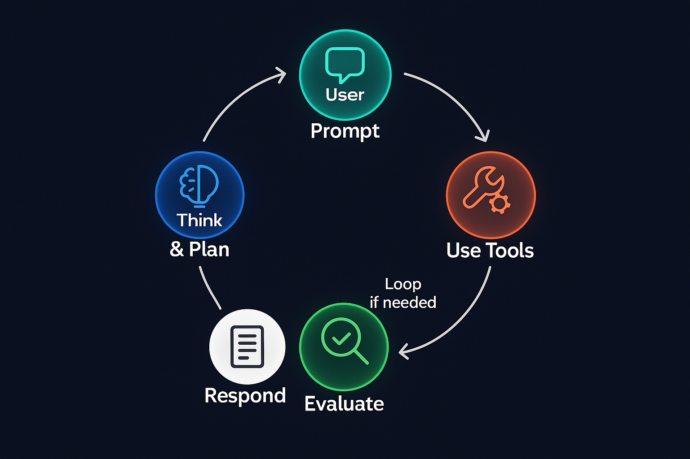
The Agentic Loop
Notes:
TIME: 3 minutes
OPEN WITH:
Claude Code doesn't just execute commands - it thinks. Here's how.
KEY POINTS:
* The agentic loop is how Claude approaches every task you give it
* It's a five-stage process: Read, Analyze, Plan, Execute, Verify
* This happens automatically - you don't trigger each stage
* Understanding this loop helps you write better prompts and anticipate Claude's actions
* Each stage has a specific purpose and happens in sequence
* If verification fails, Claude loops back to Read and tries again
REAL-WORLD EXAMPLE:
When you say 'fix the bug in auth.py', Claude doesn't just edit the file. It reads the file, analyzes the code, plans what changes to make, executes them, and then verifies they work.
TRANSITION:
Let's break down each stage in detail, starting with Read.

Slide 14
Stage 1: Read
Claude examines your codebase structure and files
Reads file structure and dependencies automatically
Scans relevant files based on your request
Builds a mental model of your project architecture
Uses .claudeignore to skip irrelevant files (node_modules, builds, etc.)
Notes:
TIME: 4 minutes
KEY POINTS:
* Read stage is reconnaissance - Claude is gathering information
* It doesn't read everything - it's smart about what's relevant to your request
* If you ask about auth, Claude reads auth.py and related files, not your entire codebase
* File structure reading is fast - it's scanning directories, not reading every file
* The .claudeignore file is critical here - it prevents Claude from wasting time on build artifacts
* Claude builds a mental model during this stage - understanding how pieces connect
REAL-WORLD EXAMPLE:
In a typical Express.js app, if you ask about routes, Claude will read the routes directory, the main server file, and possibly middleware - but not your test files or node_modules.
TRANSITION:
Once Claude has read the relevant code, it moves to analysis.

Slide 15
Stage 2: Analyze
Understands the problem or request you've given
Identifies which files need changes
Maps dependencies between components
Considers edge cases and constraints
Determines the scope of work needed
Notes:
TIME: 4 minutes
KEY POINTS:
* Analysis is where Claude thinks about what needs to happen
* It's identifying not just what file to change, but how changes will ripple through the system
* Claude considers dependencies - if I change this function signature, what else breaks?
* Edge case consideration happens here - what could go wrong with this change?
* Scope determination is important - is this a small fix or does it require refactoring?
* You might see Claude asking clarifying questions during this stage
REAL-WORLD EXAMPLE:
If you ask Claude to 'make the API endpoint async', it analyzes: which endpoint? What's calling it? Are there tests? What error handling exists? Should response format change?
TRANSITION:
After analysis comes planning.

Slide 16
Stage 3: Plan
Decides what actions to take and in what order
Sequences operations (read first, then write)
Considers risks: will this break other code?
May ask clarifying questions before proceeding
Creates an internal action plan with specific steps
Notes:
TIME: 4 minutes
KEY POINTS:
* Planning is where Claude decides the sequence of operations
* Order matters - Claude needs to read before writing, understand before modifying
* Risk assessment happens here - Claude evaluates whether changes are safe
* If Claude needs more information, it asks before executing anything
* The plan might be: read test file, read implementation, modify implementation, run tests
* You don't see the plan explicitly, but you see it reflected in Claude's tool use
REAL-WORLD EXAMPLE:
For 'add authentication to this endpoint', Claude plans: read endpoint code, read existing auth middleware, understand the pattern, apply middleware to endpoint, update tests.
TRANSITION:
Now Claude executes the plan.

Slide 17
Stage 4: Execute
Makes file changes using built-in tools
Runs commands in your terminal
Creates new files when needed
Installs dependencies if required
Each action equals one tool use (visible in logs)
Notes:
TIME: 4 minutes
KEY POINTS:
* Execute is where Claude takes action - this is where changes happen
* Tool use is visible - you see Claude calling Read, Write, Bash, etc.
* Each tool call is atomic - one specific action
* Claude can create new files, not just modify existing ones
* If dependencies are needed, Claude can run npm install or pip install
* Execution follows the plan from stage 3 - you'll see a logical sequence
REAL-WORLD EXAMPLE:
You'll see tool calls like: Read('auth.py'), Read('middleware.py'), Write('auth.py', <new content>), Bash('pytest tests/test_auth.py')
TRANSITION:
After execution, Claude doesn't just stop - it verifies the changes worked.

Slide 18
Stage 5: Verify
Checks that changes compile/run correctly
Runs existing tests if available
Reviews own output for errors
Reports results back to you
Loops back to Read if issues are found
Notes:
TIME: 4 minutes
KEY POINTS:
* Verify is quality control - Claude checks its own work
* If tests exist, Claude runs them to confirm nothing broke
* Compilation check for compiled languages - does it build?
* Claude reviews error output and can fix issues automatically
* If verification fails, Claude loops back to Read stage and tries again
* This is what makes Claude agentic - it doesn't just execute, it validates
REAL-WORLD EXAMPLE:
After modifying a Python function, Claude runs pytest. If tests fail, Claude reads the failure, analyzes what went wrong, plans a fix, executes it, and verifies again.
TRANSITION:
Let's watch the agentic loop in action with a real task.

Slide 19
DEMO
Demo: Watching the Agentic Loop
Observing Claude's thought process in real time
Notes:
TIME: 6 minutes
KEY POINTS:
* Run: claude "add input validation to the createUser function"
* Point out READ stage: watch Claude read the relevant files
* Point out ANALYZE: Claude explains what validation is needed
* Point out PLAN: Claude describes what changes it will make
* Point out EXECUTE: Watch the Write tool calls
* Point out VERIFY: Claude runs tests or checks the code
* If Claude loops back, point that out - show how it self-corrects
REAL-WORLD EXAMPLE:
Notice how you didn't tell Claude HOW to add validation - just WHAT to do. The agentic loop figured out the how.
DEMO:
Give Claude a task that requires multiple stages and point out each stage as it happens
TRANSITION:
Now that you understand how Claude thinks, let's talk about how to configure it for YOUR project.

Slide 20
CLAUDE.md Configuration
Your Project's AI Instructions
Notes:
TIME: 1 minute
KEY POINTS:
* CLAUDE.md is how you teach Claude about your specific project
* This is one of the most powerful features of Claude Code
* A good CLAUDE.md makes Claude 10x more effective
TRANSITION:
Let's start with what CLAUDE.md actually is.

Slide 21
What is CLAUDE.md?
A markdown file that tells Claude Code how to work on YOUR project
Notes:
TIME: 3 minutes
KEY POINTS:
* CLAUDE.md is a markdown file at your project root
* It contains instructions that Claude reads at the start of every conversation
* Think of it as onboarding documentation for an AI teammate
* You describe your tech stack, coding standards, testing requirements, architecture
* It's version controlled with your code - the whole team shares it
* Good CLAUDE.md means Claude makes changes that match your conventions
REAL-WORLD EXAMPLE:
Without CLAUDE.md, Claude might use single quotes when your team uses double quotes, or write class components when you prefer functional. With CLAUDE.md, Claude follows your standards.
TRANSITION:
What should you actually put in CLAUDE.md?

Slide 22
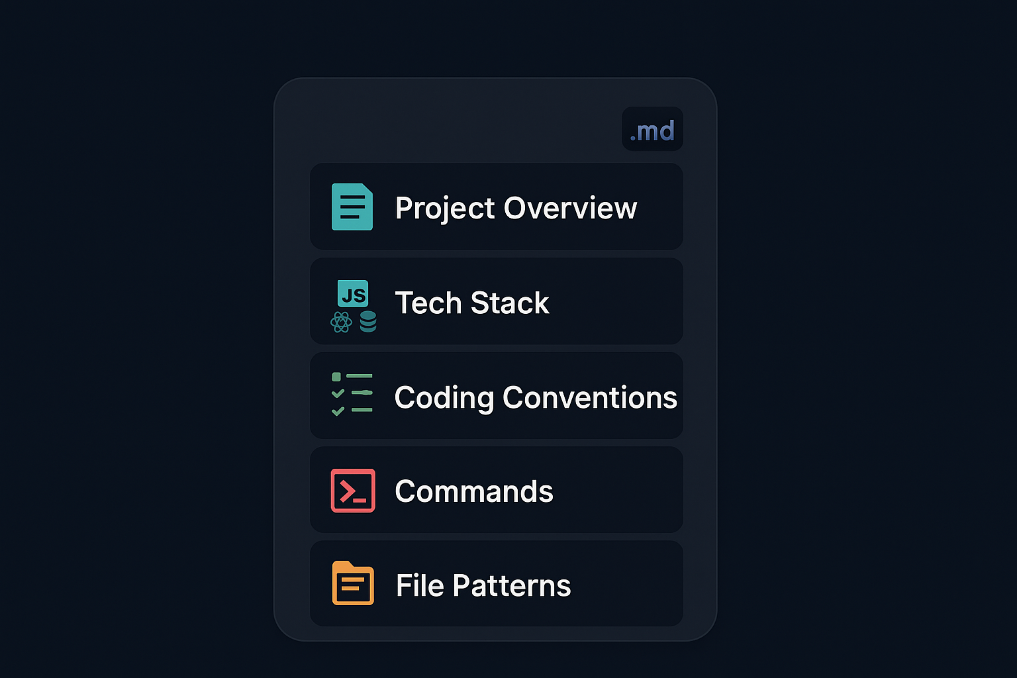
What Goes in CLAUDE.md
Notes:
TIME: 5 minutes
KEY POINTS:
* Start with a high-level overview - what does this project do?
* List your tech stack with versions - Python 3.11, not just Python
* Coding standards: formatting rules, naming conventions, architectural patterns
* Testing requirements: when to write tests, what framework, coverage expectations
* File structure: explain what goes where, especially if it's non-standard
* Common workflows: how to run tests, start dev server, build for production
* Don't write a novel - aim for 50-200 lines, concise and scannable
REAL-WORLD EXAMPLE:
If you use dependency injection, explain it in CLAUDE.md. If tests go in a specific structure, document it. These conventions aren't obvious to an AI.
TRANSITION:
Here's what a real CLAUDE.md looks like.

Slide 23
CLAUDE.md Example
MARKDOWN
# My Project ## Stack - Python 3.11 + FastAPI - PostgreSQL + SQLAlchemy - React frontend ## Rules
Notes:
TIME: 4 minutes
KEY POINTS:
* This is a minimal but effective CLAUDE.md
* Stack section tells Claude exactly what technologies you're using
* Rules section sets expectations - tests are mandatory, type hints required
* Structure section explains the non-standard directory layout
* Notice it's concise - Claude can read and understand this in seconds
* You can expand this with API patterns, error handling conventions, etc.
REAL-WORLD EXAMPLE:
With this CLAUDE.md, when you ask Claude to create a new endpoint, it will automatically add type hints, write tests, and put files in the correct directories.
TRANSITION:
CLAUDE.md can exist at multiple levels in your project.

Slide 24
CLAUDE.md Levels
Project Level
Directory Level
Root CLAUDE.md
Shared team configuration
Project-wide rules
General architecture
Applies everywhere
Subdirectory CLAUDE.md
Module-specific rules
Overrides project level
Specialized guidance
Narrower scope
Notes:
TIME: 4 minutes
KEY POINTS:
* You can have a CLAUDE.md at project root and in subdirectories
* Project-level CLAUDE.md sets defaults for everything
* Directory-level CLAUDE.md overrides or extends the project settings
* Useful for modules with different conventions - maybe your API and frontend have different styles
* Claude reads both - project-level first, then directory-level
* Don't overuse this - usually one project-level CLAUDE.md is enough
REAL-WORLD EXAMPLE:
You might have project-level CLAUDE.md saying 'use TypeScript' but a legacy/ directory CLAUDE.md saying 'this directory is vanilla JavaScript, don't convert'.
TRANSITION:
Let's create a CLAUDE.md file using the /init command.

Slide 25
DEMO
Demo: Creating CLAUDE.md with /init
Auto-generating project configuration
Notes:
TIME: 5 minutes
KEY POINTS:
* Navigate to a project directory
* Run the /init command
* Claude analyzes your project and generates a CLAUDE.md
* Show the generated file - it detects your tech stack automatically
* Point out sections: tech stack, file structure, detected patterns
* Edit the CLAUDE.md to add team-specific rules
* Add: 'Always write docstrings' or 'Use async/await for all I/O'
* Save the file and commit it to version control
REAL-WORLD EXAMPLE:
/init is great for bootstrapping, but you'll want to customize the generated CLAUDE.md to match your team's specific conventions.
DEMO:
Run /init in a real project and show the generated CLAUDE.md
TRANSITION:
Now let's talk about how to give Claude the right context using @ mentions.

Slide 26
@ Mentions & Context
Feeding Claude the Right Information
Notes:
TIME: 1 minute
KEY POINTS:
* Context is everything for AI - garbage in, garbage out
* @ mentions are how you explicitly provide context to Claude
* This section teaches you to be precise and efficient
TRANSITION:
Here's what @ mentions are and why they matter.

Slide 27
@ Mentions
Reference files, folders, URLs, and commits directly in your prompts
Notes:
TIME: 3 minutes
KEY POINTS:
* @ mentions let you explicitly tell Claude what to look at
* Syntax is simple: @filename, @directory/, @url, @git:reference
* Claude prioritizes @ mentioned context over auto-discovery
* This is how you guide Claude's attention to specific areas
* Especially useful in large codebases where auto-discovery might miss things
* Think of @ mentions as pointing - you're saying 'look here'
REAL-WORLD EXAMPLE:
Instead of 'fix the auth bug', say 'fix the bug in @src/auth/login.py'. Claude immediately focuses on that file.
TRANSITION:
Let's look at the different types of @ mentions you can use.

Slide 28
@ Mention Types
@file.py - Reference a specific file
@src/ - Reference entire directory
@https://docs.example.com - Reference a URL for context
@git:abc123 - Reference a specific commit
@git:main..feature - Reference a diff between branches
Notes:
TIME: 5 minutes
KEY POINTS:
* File mentions are most common - @auth.py, @package.json
* Directory mentions include all files in that directory - use carefully
* URL mentions are powerful - reference API docs, blog posts, specifications
* Git commit mentions let Claude see what changed in a specific commit
* Git diff mentions are great for PR reviews - @git:main..feature-branch
* You can combine multiple @ mentions in one prompt
REAL-WORLD EXAMPLE:
claude 'implement the pattern from @https://fastapi.tiangolo.com/tutorial/security/ in @src/api/auth.py'
TRANSITION:
There's a right way and wrong way to use @ mentions for context.

Slide 29
Good vs Bad Context
Good Context
Bad Context
Specific files: @auth.py
Relevant folders: @src/api/
Focused scope
Only what's needed
Saves tokens
Entire codebase: @./
Too many files at once
Unrelated context
Wastes tokens
Confuses Claude
Notes:
TIME: 4 minutes
KEY POINTS:
* Good context is specific and relevant - only what Claude needs for this task
* Bad context is throwing everything at Claude hoping something sticks
* Don't @mention your entire codebase unless you really need to
* More context isn't always better - it can actually hurt by adding noise
* Each @ mention uses tokens - be economical
* If you need to reference many files, consider if your task is too broad
REAL-WORLD EXAMPLE:
For 'fix login bug', mention @login.py and maybe @auth.py. Don't mention your entire src/ directory.
TRANSITION:
Here are some real-world examples of effective @ mention usage.

Slide 30
@ Mention Examples
BASH
claude "fix the bug in @src/auth.py" claude "refactor @src/api/ to use async" claude "review changes in @git:main..feature-branch" claude "implement the pattern from @https://docs.example.com/guide"
Notes:
TIME: 4 minutes
KEY POINTS:
* First example: specific file mention for targeted bugfix
* Second example: directory mention for broader refactoring across multiple files
* Third example: Git diff for reviewing all changes in a branch
* Fourth example: URL mention to reference external documentation
* Notice how each prompt is clear about what Claude should focus on
* You can combine approaches: file mention plus URL for pattern reference
REAL-WORLD EXAMPLE:
When implementing a feature based on documentation, always @ mention the docs URL - Claude will follow the spec exactly.
TRANSITION:
Now let's talk about managing context more broadly.

Slide 31
Context Management
What Claude Sees and How to Optimize It
Notes:
TIME: 1 minute
KEY POINTS:
* Context management is about working efficiently within token limits
* Understanding what's in context helps you use Claude more effectively
* This section is about optimization and best practices
TRANSITION:
Let's start with understanding the context window.

Slide 32
The Context Window
200K tokens ≈ 500 pages — powerful but finite
Notes:
TIME: 3 minutes
KEY POINTS:
* Claude Sonnet has a 200,000 token context window
* That's roughly equivalent to 500 pages of text
* Sounds like a lot, but it fills up faster than you think
* Every message, file read, and tool output uses tokens
* When context is full, older messages get dropped
* Good context management means staying under the limit and using tokens wisely
REAL-WORLD EXAMPLE:
A typical React component file is 100-200 tokens. You can fit hundreds of files in context, but you shouldn't - focus on what matters.
TRANSITION:
What exactly is using up that context space?

Slide 33
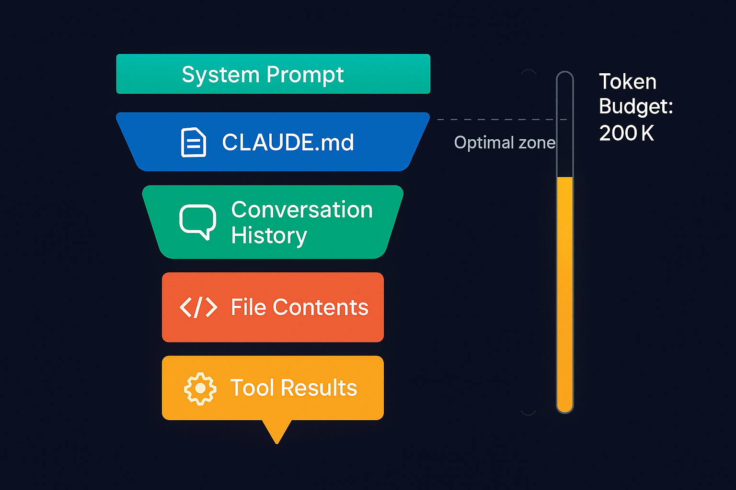
What's In Context
Notes:
TIME: 4 minutes
KEY POINTS:
* Conversation history accumulates - every message you send and Claude sends
* Files are read in full - a 1000-line file uses 1000+ tokens
* CLAUDE.md is always in context - keep it concise
* Tool outputs add up - if Claude runs tests, the output is in context
* System prompt is invisible but takes tokens
* You can see token usage with the /cost command
REAL-WORLD EXAMPLE:
In a long debugging session, you might have 50 messages, 20 files read, and dozens of test outputs - that's why context fills up.
TRANSITION:
Here are strategies to optimize your context usage.

Slide 34
Context Optimization Strategies
Start fresh conversations for new topics
Use /compact to summarize long sessions
Be specific with @ mentions (files not folders)
Use .claudeignore to exclude noise (node_modules, build/, .git)
Break large tasks into focused conversations
Notes:
TIME: 5 minutes
KEY POINTS:
* Don't try to do everything in one conversation - start new chats for new topics
* /compact command summarizes the conversation and frees up context
* Specific @ mentions are more efficient than auto-discovery
* .claudeignore prevents Claude from reading irrelevant files
* Large tasks should be broken down - do one refactor at a time, not the whole codebase
* Think of context as RAM - you wouldn't try to load your entire hard drive
REAL-WORLD EXAMPLE:
If you're working on frontend and then switch to backend, start a new conversation. Claude doesn't need the frontend context anymore.
TRANSITION:
The .claudeignore file is crucial for context management.

Slide 35
.claudeignore Example
TEXT
# .claudeignore node_modules/ build/ dist/ .git/ *.lock *.min.js coverage/
Notes:
TIME: 4 minutes
KEY POINTS:
* .claudeignore works exactly like .gitignore - same syntax
* node_modules is the most important exclusion - thousands of files you don't need
* Build outputs (build/, dist/) are generated code, not source
* .git directory is internal Git data - irrelevant to Claude
* Lock files and minified JS are large and not human-readable
* Coverage reports are generated data
* .env files should be excluded for security AND efficiency
* Create .claudeignore as one of your first steps in any project
REAL-WORLD EXAMPLE:
Without .claudeignore, Claude might try to read node_modules and fill your entire context window with dependency code.
TRANSITION:
How do you know when to start a fresh conversation?

Slide 36
When to Start Fresh
Keep Going
Start New Chat
Related follow-up task
Iterating on same code
Building on previous context
Refining a solution
Context still relevant
Different topic/module
Context getting long
Claude seems confused
New bug unrelated to current work
Switching codebases
Notes:
TIME: 4 minutes
KEY POINTS:
* Keep going when the new task builds on previous work
* If you're fixing a bug and then need to add a related feature, stay in the conversation
* Start fresh when switching to unrelated work
* If conversation is getting long (50+ messages), consider starting fresh
* If Claude seems confused or is making mistakes, fresh start often helps
* Don't feel bad about starting new chats - it's a feature, not a limitation
REAL-WORLD EXAMPLE:
You fix a login bug, then add a forgot-password feature - keep going. You fix login bug, then switch to optimizing database queries - start fresh.
TRANSITION:
Let's see context management in action.

Slide 37
DEMO
Demo: Context Optimization
Using /compact, .claudeignore, and token management
Notes:
TIME: 5 minutes
KEY POINTS:
* Show a long conversation and run /cost to see token usage
* Point out how many tokens are being used
* Run /compact command to summarize the conversation
* Show the reduction in token usage after compaction
* Open a project without .claudeignore and show Claude trying to read node_modules
* Create a .claudeignore file with standard exclusions
* Show Claude now skips those directories
* Run /cost again to demonstrate the difference
REAL-WORLD EXAMPLE:
Notice how .claudeignore cut token usage by 80% - we went from Claude trying to read 10,000 files to just 200.
DEMO:
Demonstrate practical context management techniques
TRANSITION:
Let's take a 15-minute break, then we'll do Lab 1 where you'll apply everything we've learned.

Slide 38
Break
15 minutes | Return for Lab 1
Notes:
TIME: 1 minute
KEY POINTS:
* Take a 15-minute break - stretch, coffee, bathroom
* When we return, we'll start Lab 1
* Lab 1 is hands-on setup and your first real project with Claude
* Make sure your environment is ready - Claude Code installed, API key set
TRANSITION:
See you in 15 minutes for Lab 1.

Slide 39
LAB
45 minutes
Lab 1: Setup & First Project
1
Install Claude Code and verify it works (claude --version)
2
Initialize a project with /init command
3
Configure CLAUDE.md for your tech stack
4
Practice @ mentions with real files in your project
5
Complete 3 coding tasks with Claude (bug fix, feature add, refactor)
6
Share your CLAUDE.md with the class
Notes:
TIME: 45 minutes
KEY POINTS:
* This is hands-on time - everyone should be coding
* Step 1: Make sure Claude Code is installed and working
* Step 2: Use /init in a real project or our sample project
* Step 3: Edit the generated CLAUDE.md to match your preferences
* Step 4: Practice using @file and @directory mentions
* Step 5: Give Claude three real tasks - fix a bug, add a small feature, refactor a function
* Step 6: Share your CLAUDE.md - learn from each other's approaches
* Instructors will circulate to help with issues
* Don't rush - it's better to do this thoroughly than quickly
REAL-WORLD EXAMPLE:
By the end of this lab, you should feel comfortable starting Claude, configuring a project, and using it for basic development tasks.
TRANSITION:
After lab, we'll dive into slash commands and advanced features.

Slide 40
Slash Commands
Power User Controls
Notes:
TIME: 1 minute
KEY POINTS:
* Slash commands are built-in controls for Claude Code
* They control behavior, switch models, manage sessions
* Power users use these constantly
TRANSITION:
Let's start with what slash commands are.

Slide 41
Slash Commands
Built-in commands that control Claude Code behavior
Notes:
TIME: 2 minutes
KEY POINTS:
* Slash commands start with / and are recognized by Claude Code
* They're different from your normal prompts - they control the tool itself
* Think of them as meta-commands - commands about commands
* They don't count as conversation messages
* Every slash command has a specific purpose
* Type /help to see all available commands
REAL-WORLD EXAMPLE:
/model is like switching gears in a car - same engine, different performance characteristics.
TRANSITION:
Let's look at the essential commands everyone should know.

Slide 42
Essential Commands
1
2
3
/init - Initialize project and create CLAUDE.md
/compact - Summarize conversation and free up context
/clear - Reset conversation completely
Notes:
TIME: 4 minutes
KEY POINTS:
* /init is your first command in any new project - auto-generates CLAUDE.md
* /compact is for long sessions - summarizes history and reduces token usage
* /clear is nuclear option - fresh start, all context gone
* Use /init once per project setup
* Use /compact when context is getting full but you want to keep working
* Use /clear when switching to completely different work
* These three commands cover 80% of your session management needs
TRANSITION:
Now let's look at control commands that modify Claude's behavior.

Slide 43
Control Commands
1
2
3
/model - Switch models (haiku/sonnet/opus)
/thinking - Set thinking level (off/low/medium/high)
/permissions - View and modify tool permissions
Notes:
TIME: 4 minutes
KEY POINTS:
* /model lets you switch between Claude models mid-session
* Haiku is fast and cheap, Sonnet is balanced, Opus is most capable
* /thinking controls how much reasoning Claude shows you
* Higher thinking levels make Claude explain its reasoning step-by-step
* /permissions shows what tools Claude can use and lets you modify them
* These commands let you tune Claude's performance for your specific task
REAL-WORLD EXAMPLE:
Use Sonnet for most work, switch to Opus for complex refactoring or architecture decisions, use Haiku for simple grep-like tasks.
TRANSITION:
There are more utility commands for session management.

Slide 44
Session Commands
/status - Show current session info (model, tokens used, permissions)
/cost - Display token usage and estimated cost
/doctor - Diagnose configuration issues
/bug - Report a bug to Anthropic
/help - Show all available commands
Notes:
TIME: 4 minutes
KEY POINTS:
* /status is your dashboard - shows everything about current session
* /cost breaks down token usage and estimates API costs
* /doctor runs diagnostics - checks API key, network, permissions
* /bug is how you report issues to Anthropic directly from CLI
* /help lists all commands with brief descriptions
* Use /status and /cost regularly to monitor your usage
* Run /doctor when something isn't working right
REAL-WORLD EXAMPLE:
Run /cost at the end of a session to see how many tokens you used - helps with budget planning.
TRANSITION:
Let's see these commands in action.

Slide 45
Commands in Action
BASH
/init # Set up new project /model opus # Switch to Opus for complex task /thinking high # Enable deep reasoning /compact # Summarize when context is long /permissions # Check what Claude can do /clear # Fresh start
Notes:
TIME: 3 minutes
KEY POINTS:
* This is a realistic command sequence for a work session
* Start with /init to configure the project
* Switch to Opus for a particularly complex task
* Enable high thinking to understand Claude's reasoning
* Use /compact when context fills up but you're not done
* Check /permissions to verify Claude can use the tools you need
* End with /clear when switching to different work
* Commands are lightweight - they execute instantly
TRANSITION:
When should you use each command?

Slide 46
When to Use Which
Start of Session
During Work
/init for new projects
/model to choose model
/permissions to verify access
/status to check config
/compact when context fills
/thinking for complex tasks
/clear for topic change
/cost to monitor usage
Notes:
TIME: 3 minutes
KEY POINTS:
* Session start commands set up your environment
* /init only needed once per project, not every session
* During work, use commands as needed for optimization
* /compact is reactive - use when you notice context getting full
* /thinking is proactive - enable when you want to understand reasoning
* /clear is a reset button - use sparingly
* Build habits around these commands - they'll become second nature
TRANSITION:
Let's see command mastery in a live demo.

Slide 47
DEMO
Demo: Command Mastery
Using multiple commands in a real session
Notes:
TIME: 5 minutes
KEY POINTS:
* Start with /status to show current configuration
* Run /model sonnet to ensure we're on Sonnet
* Give Claude a coding task
* Mid-task, run /thinking high to see reasoning
* Run /cost to show token usage so far
* Continue the task
* Run /compact to summarize the session
* Show how context is freed up
* End with /clear for fresh start
REAL-WORLD EXAMPLE:
Notice how commands integrate seamlessly - they don't interrupt the flow of work.
DEMO:
Walk through a real session using various commands
TRANSITION:
Now let's talk about security and permissions.

Slide 48
Permissions & Security
Controlling What Claude Code Can Do
Notes:
TIME: 1 minute
KEY POINTS:
* Security is critical when giving AI access to your system
* Claude Code has built-in safety features
* This section is about using those features correctly
TRANSITION:
Let's start with Claude Code's security model.

Slide 49
Security Model
Claude Code asks permission before executing potentially dangerous actions
Notes:
TIME: 3 minutes
KEY POINTS:
* Claude Code uses a permission-based security model
* Some operations are auto-approved (reads), others require your approval (writes)
* Really dangerous operations can be blocked entirely
* You control the permission levels through configuration
* Default settings are conservative - Claude asks before doing anything risky
* You can customize permissions per project or globally
REAL-WORLD EXAMPLE:
Claude can read files freely, but before running 'rm -rf', it will ask you to confirm.
TRANSITION:
Let's break down the permission levels.

Slide 50
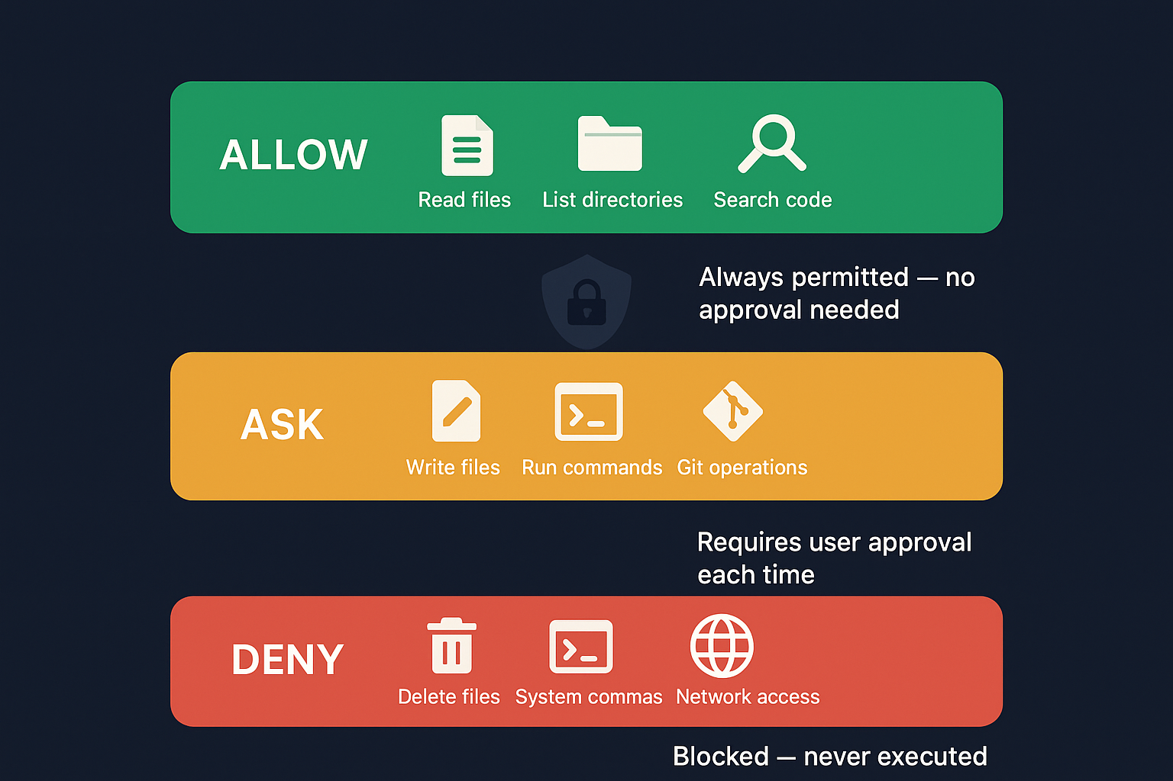
Permission Levels
Notes:
TIME: 4 minutes
KEY POINTS:
* Left side: operations that are safe and auto-approved
* Reading code can't break anything - these are green-lit
* Right side: operations that modify your system
* Writing files, running commands, deleting - these need approval
* Approval can be per-operation or allowlisted
* You'll see a prompt asking you to confirm before Claude executes
* You can say yes, no, or allowlist the operation
REAL-WORLD EXAMPLE:
When Claude wants to run 'npm install', you'll see a prompt showing the exact command. You can approve, deny, or allowlist npm commands.
TRANSITION:
How do you configure these permissions?

Slide 51
Configuring Permissions
/permissions command to view current settings
Allowlist specific tools: /permissions add Bash(git*)
Blocklist dangerous commands
Per-session or persistent configuration
Team-wide defaults in CLAUDE.md
Notes:
TIME: 4 minutes
KEY POINTS:
* /permissions shows what's currently allowed and blocked
* Allowlisting is powerful - you can say 'always allow git commands'
* Syntax: /permissions add Bash(git*) - allows any command starting with git
* Blocklisting prevents certain operations entirely
* Permissions can be session-only or saved persistently
* Put team-wide permission defaults in CLAUDE.md
* Balance security with productivity - allowlist safe, repetitive commands
REAL-WORLD EXAMPLE:
Allowlist 'npm test' and 'pytest' so Claude can run tests freely, but require approval for 'npm install'.
TRANSITION:
Security also extends to what files Claude can see.

Slide 52
.claudeignore for Security
TEXT
# Protect sensitive files .env .env.* secrets/ *.pem *.key config/production.yml
Notes:
TIME: 4 minutes
KEY POINTS:
* .claudeignore serves dual purpose: efficiency and security
* Top section: sensitive files that Claude should never read
* .env files contain API keys and secrets - always exclude
* Certificates and private keys (.pem, .key) must be excluded
* Production config files might have sensitive data
* Bottom section: large irrelevant directories
* node_modules, .git, build/ don't contain source code Claude needs
* Always create .claudeignore before using Claude Code in production
REAL-WORLD EXAMPLE:
If Claude reads your .env file, those secrets are in context and might accidentally leak into logs or responses.
TRANSITION:
Let's talk about security best practices.

Slide 53
Security Best Practices
Never run Claude Code with root/admin privileges
Use .claudeignore for secrets (.env, API keys, certificates)
Review file changes before committing (git diff)
Start with restrictive permissions and expand as needed
Use allowlists for known-safe commands (git, npm test, pytest)
Audit Claude's actions in long sessions
Notes:
TIME: 5 minutes
KEY POINTS:
* Never use sudo with Claude Code - run as regular user
* .claudeignore is your first line of defense for sensitive data
* Always review changes with git diff before committing
* Start conservative with permissions, then relax as you trust the workflow
* Allowlist common, safe commands so you're not clicking approve constantly
* In long sessions, periodically review what Claude has done
* Remember: Claude is powerful but not perfect - human oversight is essential
REAL-WORLD EXAMPLE:
In production, have one developer configure .claudeignore and permissions, then share that config with the team via Git.
TRANSITION:
Let's demo secure configuration.

Slide 54
DEMO
Demo: Secure Configuration
Setting up .claudeignore, permissions, and approval prompts
Notes:
TIME: 5 minutes
KEY POINTS:
* Create .claudeignore file with sensitive exclusions
* Add .env, secrets/, *.key, *.pem
* Run /permissions to show default settings
* Give Claude a task that requires file writing
* Show the approval prompt that appears
* Approve the action and show it executes
* Now allowlist: /permissions add Bash(git*)
* Show that git commands no longer prompt
* Run /permissions again to show the updated config
REAL-WORLD EXAMPLE:
This setup takes 5 minutes but protects you from accidentally leaking secrets or running dangerous commands.
DEMO:
Show comprehensive security setup
TRANSITION:
Let's take a quick break before diving into Git integration.

Slide 55
Break
15 minutes
Notes:
TIME: 1 minute
KEY POINTS:
* 15-minute break
* After break: Git integration and real development workflows
* We're entering the most powerful features of Claude Code
TRANSITION:
See you in 15 minutes.

Slide 56
Git Integration
AI-Powered Version Control Workflows
Notes:
TIME: 1 minute
KEY POINTS:
* Git integration is where Claude Code becomes a true development partner
* Automated commits, smart branching, PR creation
* This is production-ready AI assistance
TRANSITION:
Let's see what Git + Claude Code can do.

Slide 57
Git + Claude Code
Automated commits, smart branching, and PR creation
Notes:
TIME: 3 minutes
KEY POINTS:
* Claude Code integrates deeply with Git
* It can create branches, commit changes, write commit messages, and create PRs
* All automated but with human oversight
* Claude writes meaningful commit messages based on the actual changes
* You approve before anything is pushed
* This turns Claude from a code generator into a full development partner
REAL-WORLD EXAMPLE:
Ask Claude to 'add authentication to this endpoint and commit the changes' - it will implement, test, commit with a good message, all in one go.
TRANSITION:
Let's look at the auto-commit workflow.

Slide 58
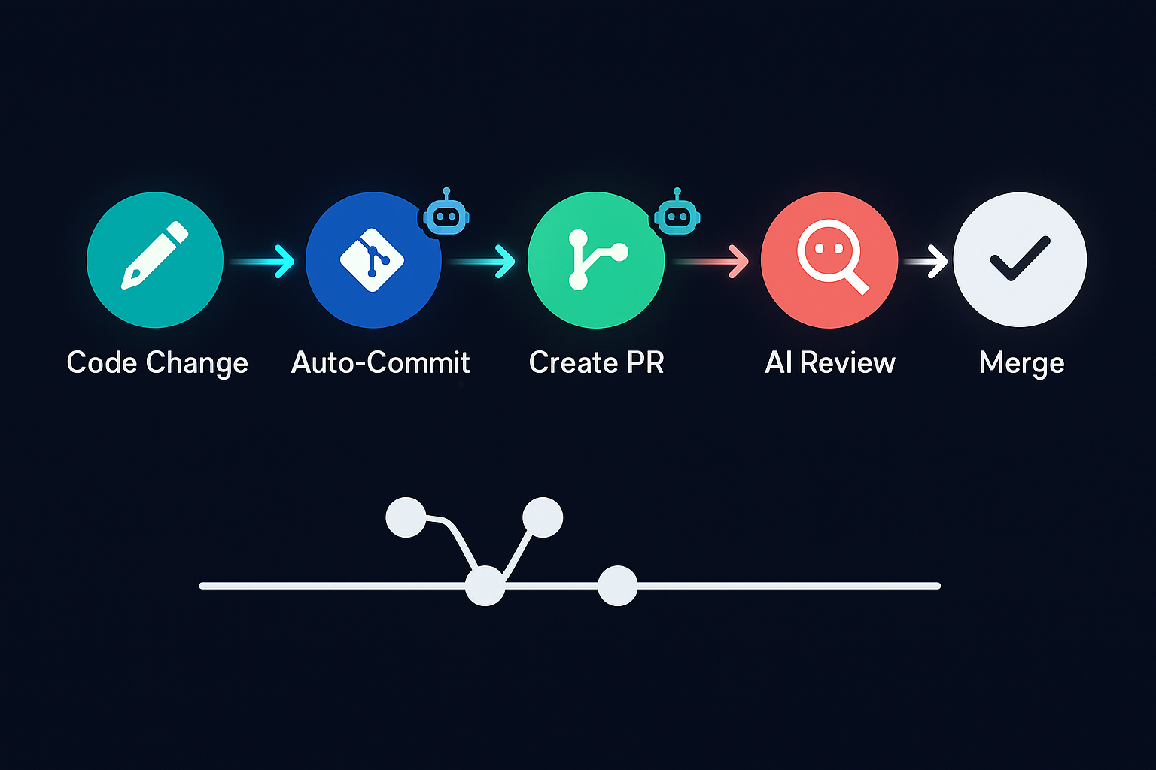
Auto-Commit Workflows
Notes:
TIME: 4 minutes
KEY POINTS:
* Claude generates commit messages by analyzing what actually changed
* Messages are descriptive: 'Add email validation to user registration form'
* Atomic commits: one logical change per commit, not mixing features
* If you use conventional commits (feat:, fix:, docs:), configure it in CLAUDE.md
* You see the commit message before it's committed - you can edit or approve
* Claude can intelligently split changes into multiple commits or batch related changes
REAL-WORLD EXAMPLE:
If Claude refactors a function and adds tests, it might make two commits: 'refactor: extract validation logic' and 'test: add validation tests'.
TRANSITION:
Here are practical Git commands you can use with Claude.

Slide 59
Git Commands with Claude
BASH
claude "create a branch for the auth refactor" claude "commit these changes with a good message" claude "what changed since yesterday? review the git log" claude "create a PR for this feature branch"
Notes:
TIME: 4 minutes
KEY POINTS:
* First command: Claude creates a descriptively named branch
* Second: Claude writes and makes a commit with meaningful message
* Third: Claude analyzes git log and summarizes recent changes
* Fourth: Claude creates a PR with title, description, and change summary
* Fifth: Claude squashes commits and writes a clean summary message
* Notice you're using natural language - no need to remember git command syntax
REAL-WORLD EXAMPLE:
'create a PR for this feature branch' - Claude generates PR title, description, lists all changes, adds context. You just review and submit.
TRANSITION:
Let's look at different branching workflows.

Slide 60
Branching Workflows
Feature Branch
Hotfix
Claude creates feature branch
Makes changes incrementally
Commits as you go
Creates PR when done
Comprehensive change summary
Start from main/master
Targeted fix only
Single atomic commit
Merge immediately
Minimal scope
Notes:
TIME: 4 minutes
KEY POINTS:
* Feature branch workflow: iterative development with multiple commits
* Claude manages the branch, makes changes, commits, creates PR
* Hotfix workflow: urgent fix on main, single commit, fast merge
* Claude adapts to which workflow you're using
* For features: claude 'create a feature branch and add user profile editing'
* For hotfixes: claude 'fix the login timeout bug and commit to main'
* Both workflows maintain clean Git history
REAL-WORLD EXAMPLE:
Feature branches might have 5-10 commits over days. Hotfixes are one commit, merged in minutes.
TRANSITION:
Claude can also create pull requests with comprehensive descriptions.

Slide 61
Pull Request Creation
Claude generates PR title and description automatically
Includes summary of all changes
Lists files modified with explanations
Adds testing notes
Links to related issues (if configured)
You review and submit
Notes:
TIME: 4 minutes
KEY POINTS:
* Claude analyzes all commits in the branch to generate PR content
* PR title is concise but descriptive
* Description includes: what changed, why, how to test
* Files are listed with brief explanation of what changed in each
* If you mention issue numbers, Claude can link them
* Testing section tells reviewers what to check
* You get a preview and can edit before creating the PR
REAL-WORLD EXAMPLE:
Claude might generate: 'feat: Add password reset flow - Implements password reset via email token. Modified: auth.py (added reset endpoints), email.py (added reset email template). Tests: test_auth.py covers happy path and error cases.'
TRANSITION:
Claude can also analyze Git history and review changes.

Slide 62
Git History Analysis
Ask Claude to explain recent changes
Compare branches: 'What's different between main and feature?'
Blame analysis: 'Who changed this function and why?'
Review PRs: 'Review this PR for issues'
Find when bugs were introduced: 'When did this break?'
Notes:
TIME: 4 minutes
KEY POINTS:
* Claude can read and analyze git log, git diff, git blame
* Great for understanding what happened: 'explain the last 5 commits'
* Branch comparison: Claude shows what's new in your feature branch
* Git blame: Claude explains who changed code and the context from commit messages
* PR review: give Claude a PR diff and ask for review
* Bug archaeology: 'when did the login timeout start happening?'
REAL-WORLD EXAMPLE:
When joining a project mid-stream, ask Claude: 'what changed in the auth module over the last month?' - instant project history.
TRANSITION:
Let's see an end-to-end Git workflow with Claude.

Slide 63
DEMO
Demo: End-to-End Git Workflow
Branch creation, changes, commits, and PR - all with Claude
Notes:
TIME: 6 minutes
KEY POINTS:
* Start: claude 'create a branch for adding rate limiting'
* Show branch is created with descriptive name
* Ask: claude 'add rate limiting to the API endpoints'
* Watch Claude implement the feature
* Ask: claude 'commit these changes'
* Show commit message Claude generates - review and approve
* Ask: claude 'create a PR for this branch'
* Show PR title, description, file list, testing notes
* Review the PR content - show how comprehensive it is
REAL-WORLD EXAMPLE:
This entire workflow - branch, implement, commit, PR - took 5 minutes and is production-ready.
DEMO:
Show complete feature development workflow
TRANSITION:
Now let's talk about general file operations and real development workflows.

Slide 64
File Operations & Workflows
Real Development with Claude Code
Notes:
TIME: 1 minute
KEY POINTS:
* This section covers day-to-day development tasks
* How to use Claude for debugging, refactoring, testing
* These are the workflows you'll use every single day
TRANSITION:
Let's start with core file operations.

Slide 65
File Operations
Read, write, search, and refactor across your entire codebase
Notes:
TIME: 2 minutes
KEY POINTS:
* Claude Code can perform any file operation you can
* Read files to understand code
* Write files to make changes
* Search across codebase for patterns
* Refactor multiple files in coordination
* All operations respect your Git workflow and require appropriate permissions
REAL-WORLD EXAMPLE:
claude 'rename the User class to Account everywhere in the codebase' - Claude finds all references and updates them consistently.
TRANSITION:
Let's break down the core operations.

Slide 66
Core Operations
1
2
3
Read - Examine files, understand code, trace dependencies
Write - Create new files, modify existing, multi-file edits
Search - Find patterns, grep across codebase, locate definitions
Notes:
TIME: 4 minutes
KEY POINTS:
* Read: Claude examines your code to understand structure and logic
* Claude can trace how functions call each other across files
* Write: Claude can create new files from scratch or modify existing ones
* Multi-file edits maintain consistency - same pattern applied everywhere
* Search: Claude can find patterns, locate definitions, identify usage
* Search is more semantic than grep - Claude understands meaning
* All three operations work together in the agentic loop
TRANSITION:
How does Claude generate code that matches your style?

Slide 67
Code Generation Patterns
Describe what you want in plain English
Claude reads existing code for patterns and style
Generates code matching your project conventions
Creates test files alongside implementation
Adds documentation as it goes
Notes:
TIME: 4 minutes
KEY POINTS:
* You describe the feature in natural language - no need to specify implementation
* Claude reads your existing code to understand your patterns
* If you use dependency injection, Claude will too
* If you format strings a certain way, Claude matches that
* Generated code follows your naming conventions automatically
* Claude creates tests in the same style as your existing tests
* Documentation and comments match your project's style
REAL-WORLD EXAMPLE:
claude 'add a new endpoint for deleting users' - Claude looks at existing endpoints, follows the same pattern, adds similar tests.
TRANSITION:
Let's look at the debugging workflow.

Slide 68
Debugging Workflow
You Provide
Claude Does
Error message/stack trace
Steps to reproduce
Expected behavior
Maybe relevant logs
Reads relevant code
Traces the bug
Proposes fix
Implements and tests
Verifies it's fixed
Notes:
TIME: 4 minutes
KEY POINTS:
* Give Claude the error message - paste the full stack trace
* Explain how to reproduce - what steps trigger the bug
* Describe what should happen instead
* Claude reads the code mentioned in the stack trace
* Claude traces through the logic to find the root cause
* Claude proposes a fix and explains why it works
* Claude implements the fix and runs tests to verify
* If tests fail, Claude iterates until they pass
REAL-WORLD EXAMPLE:
Paste a NullPointerException stack trace, say 'this happens when users with no profile try to login', Claude finds and fixes the null check bug.
TRANSITION:
Refactoring is another common workflow.

Slide 69
Refactoring Patterns
Extract function/method: 'Break this into smaller functions'
Rename across codebase: 'Rename UserService to AuthService everywhere'
Change architecture: 'Convert this to async/await pattern'
Add types: 'Add TypeScript types to this module'
Dead code removal: 'Find and remove unused functions'
Notes:
TIME: 4 minutes
KEY POINTS:
* Claude excels at refactoring - it sees the whole codebase
* Extract function: Claude identifies logical units and extracts them
* Renaming: Claude finds all uses and updates consistently
* Architecture changes: Claude can convert callbacks to promises, sync to async
* Adding types: Claude infers types from usage and adds annotations
* Dead code: Claude finds functions never called and removes them safely
* All refactoring maintains tests and functionality
REAL-WORLD EXAMPLE:
'convert this Express route to async/await' - Claude rewrites all callbacks, adds try/catch, updates tests.
TRANSITION:
Test generation is a powerful Claude Code feature.

Slide 70
Test Generation
claude 'write tests for @src/auth.py'
Generates unit tests matching your framework (pytest, jest, etc.)
Covers happy path, edge cases, error handling
Follows existing test patterns in your project
Can generate test data and fixtures
Notes:
TIME: 4 minutes
KEY POINTS:
* Claude can generate comprehensive tests for existing code
* It detects your test framework by reading existing tests
* Tests cover normal cases, edge cases, and error conditions
* Claude follows your test structure - if you group by class, Claude does too
* Test data and fixtures are generated realistically
* Claude can also add tests when generating new features
* This dramatically improves code coverage
REAL-WORLD EXAMPLE:
Give Claude a 200-line authentication module, ask for tests, get 500 lines of comprehensive test coverage in minutes.
TRANSITION:
Let's watch a real debugging session with Claude.

Slide 71
DEMO
Demo: Real Debugging Session
Finding, fixing, and testing a real bug
Notes:
TIME: 6 minutes
KEY POINTS:
* Show a failing test or error message
* Paste the error to Claude: 'fix this bug' + stack trace
* Watch Claude read the relevant files
* Claude explains what's causing the bug
* Claude proposes a fix
* Claude implements the fix
* Claude runs tests to verify
* If tests still fail, watch Claude iterate
* Show the final fix and passing tests
REAL-WORLD EXAMPLE:
Notice how Claude didn't just patch the symptom - it found the root cause and fixed it properly.
DEMO:
Give Claude a real bug to debug and fix
TRANSITION:
Now let's apply everything you've learned in Lab 2.

Slide 72
LAB
45 minutes
Lab 2: Real Development Workflow
1
Clone the sample project with known bugs
2
Use Claude to find and fix 3 bugs
3
Write tests for the fixed code
4
Refactor one module following best practices
5
Generate API documentation
6
Create a PR with all changes using Claude
Notes:
TIME: 45 minutes
KEY POINTS:
* This is a realistic development workflow from start to finish
* Step 1: Clone the provided sample project (or use your own)
* Step 2: Give Claude the failing tests, have it find and fix 3 bugs
* Step 3: Use Claude to generate tests for the fixed code
* Step 4: Pick a messy module and have Claude refactor it
* Step 5: Generate API documentation with Claude
* Step 6: Create a branch, commit all changes, create a PR - all via Claude
* This lab combines everything: debugging, testing, refactoring, Git workflow
* By the end, you should feel confident using Claude Code for real work
REAL-WORLD EXAMPLE:
This workflow mirrors what you'll do on Monday at your desk. Same tools, same process.
TRANSITION:
After lab, we'll wrap up with key takeaways and resources.

Slide 73
Key Takeaways
v
The Agentic Loop is the foundation (Read-Analyze-Plan-Execute-Verify)
v
CLAUDE.md is your project's AI instruction manual
v
Context management = better results (be specific with @ mentions)
v
Security first: .claudeignore and permissions before coding
v
Git integration makes Claude a full development partner
v
Iterate: first attempt is 70% — refine to 95%
Notes:
TIME: 5 minutes
KEY POINTS:
* Understanding the agentic loop changes how you prompt Claude
* Always create CLAUDE.md - it's 10 minutes that saves hours
* Good context management means better results and lower costs
* Security isn't optional - set up .claudeignore and permissions first
* Git integration is what makes Claude truly productive
* Claude won't be perfect on first try - iterate and refine
* These aren't just tips - they're the foundation of effective Claude Code use
REAL-WORLD EXAMPLE:
Teams that follow these practices report 40-60% productivity gains. Teams that don't struggle with Claude.
TRANSITION:
Here are resources for continuing your learning.

Slide 74
Resources
Claude Code Docs: docs.anthropic.com/en/docs/claude-code
Anthropic Blog: anthropic.com/news
Claude Code Cheat Sheet (in handouts)
Tomorrow: Advanced topics (custom commands, hooks, MCP, Agent Teams)
Your instructors are available for questions anytime
Notes:
TIME: 3 minutes
KEY POINTS:
* Official docs are comprehensive and up to date
* Anthropic blog announces new features and best practices
* Cheat sheet in your handouts covers all slash commands and common workflows
* Tomorrow we go advanced: custom commands, Git hooks, Model Context Protocol, Agent Teams
* We're here to help - ask questions in Slack, schedule 1:1s if needed
* Practice between now and tomorrow - the more you use it, the better you'll get
TRANSITION:
Thank you for your attention today. See you tomorrow!

Slide 75
Thank You
- © 2026 AIA Copilot
Notes:
TIME: 2 minutes
KEY POINTS:
* Great work today - you've learned the fundamentals of Claude Code
* You should now feel comfortable installing, configuring, and using Claude Code
* Tomorrow we level up with advanced features
* Tonight: practice what you learned, try Claude Code on a real project
* Questions? Find us in Slack or grab us after class
* See you tomorrow for Day 3!

